Slide 1

Customer Shopping Behavior Analysis
Uncovering insights from 3,900 purchases to guide strategic business decisions through data-driven analysis of spending patterns, customer segments, and product preferences.

Slide 2
DATASET OVERVIEW
Understanding Our Data Foundation
3,900
18
50
Total Purchases
Data Points
Locations
Transactions analyzed across all categories
Features per customer transaction
Geographic coverage across regions
Key Features Tracked
Customer demographics: Age, Gender, Location, Subscription Status
Purchase details: Item, Category, Amount, Season, Size, Color
Shopping behavior: Discounts, Promo Codes, Previous Purchases, Review Ratings, Shipping Type

Slide 3

PYTHON ANALYSIS
Data Preparation & Cleaning Process
01
02
Data Loading & Exploration
Missing Data Handling
Imported dataset using pandas, checked structure with df.info() and summary statistics
Imputed 37 missing Review Rating values using median rating per product category
03
04
Feature Engineering
Database Integration
Created age_group bins and purchase_frequency_days columns for deeper analysis
Connected to PostgreSQL and loaded cleaned data for SQL business analysis

Slide 4

SQL ANALYSIS
Key Business Insights
Structured analysis in PostgreSQL revealed critical patterns across revenue, customer behavior, and product performance to answer strategic business questions.

Slide 5
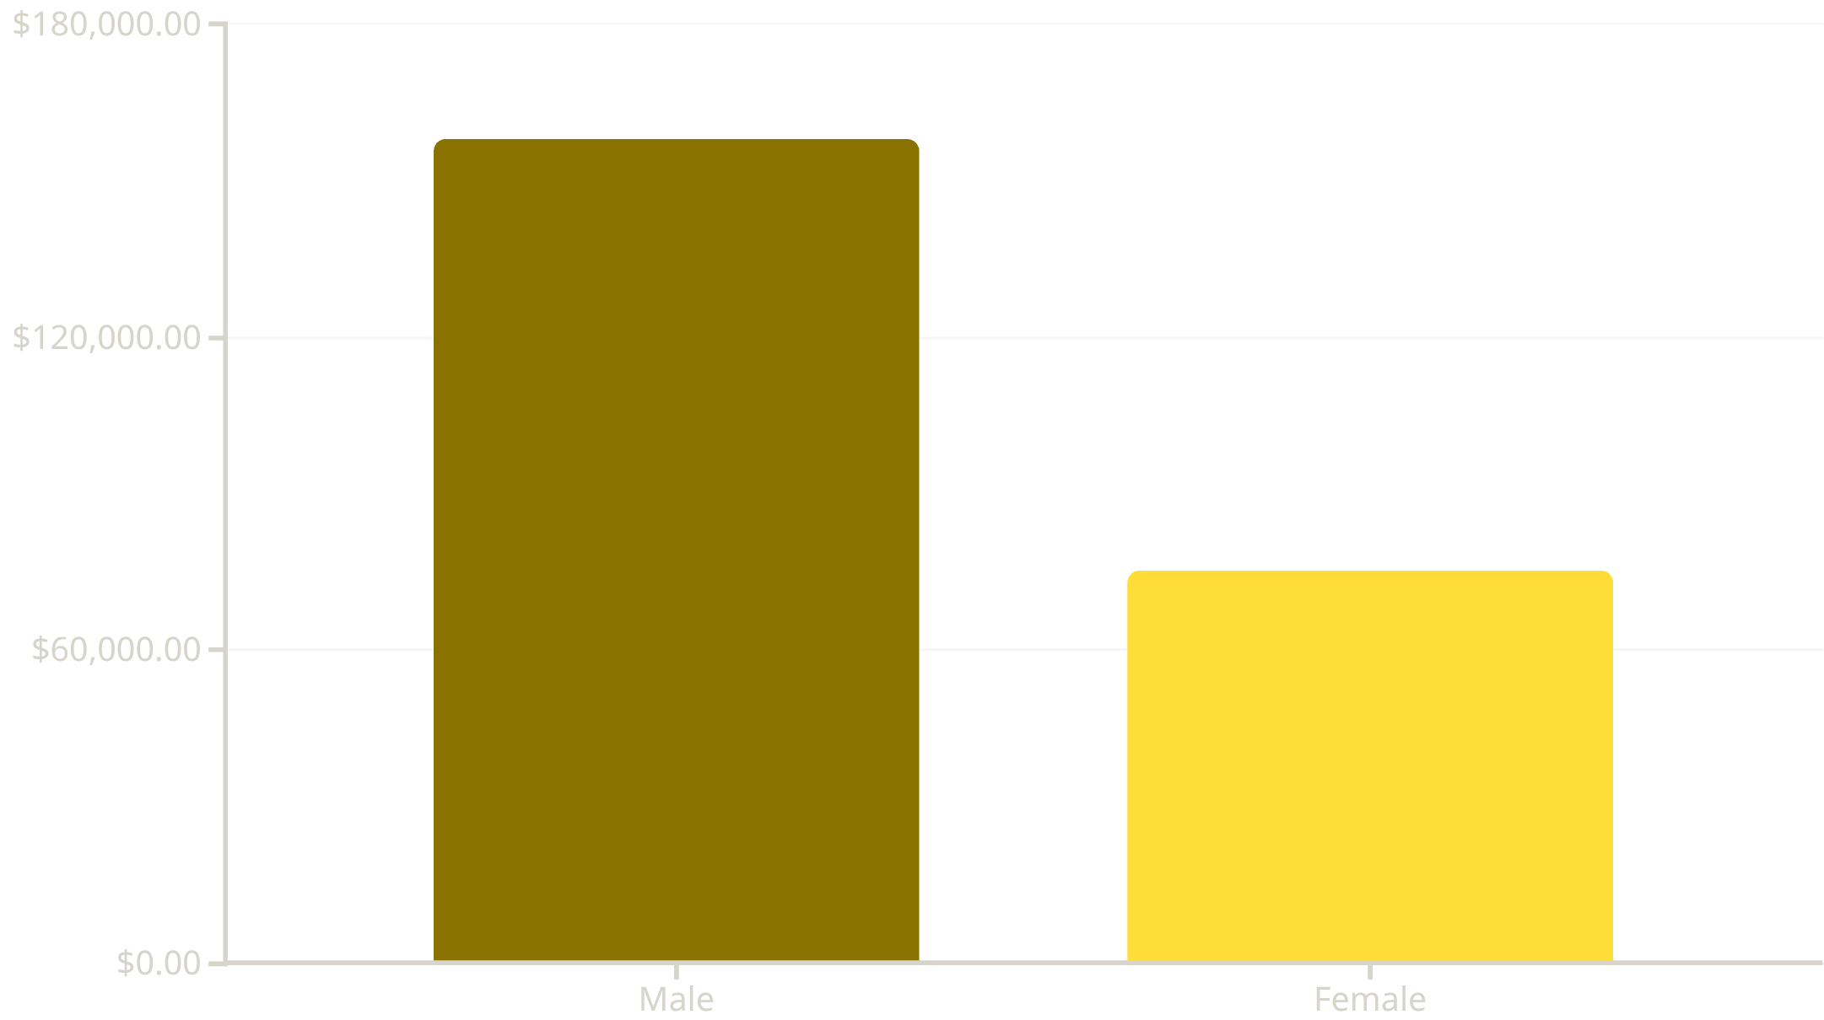
Revenue & Customer Spending Patterns
Gender Revenue Analysis
Male customers generate 68% of total revenue ($157,890) compared to female customers ($75,191), indicating a significant opportunity for targeted marketing campaigns.
High-Spending Discount Users: 839 customers used discounts but still spent above average ($60), showing price sensitivity doesn't always mean lower spending.

Slide 6





Top-Performing Products & Shipping Insights
Gloves
Sandals
Boots
Hat
Highest rated at 3.86 stars
Strong rating of 3.84 stars
Rated 3.82 stars by customers
Solid 3.80 star rating
Express shipping customers spend $60.48 on average vs. $58.46 for Standard—a 3.5% premium indicating willingness to pay for convenience.

Slide 7
Subscription Status Impact
Subscriber vs. Non-Subscriber Metrics
Discount Dependency
Top 5 Products by Discount Rate:
Subscribers (27%): 1,053 customers generating $62,645 revenue
Non-Subscribers (73%): 2,847 customers generating $170,436 revenue
Average Spend: Nearly identical at $59.49 vs. $59.87
Hat: 50% discount rate
Sneakers: 49.66%
Coat: 49.07%
Sweater: 48.17%
Pants: 47.37%
Despite similar spending, the 73% non-subscriber base represents massive untapped potential for subscription conversion programs.

Slide 8
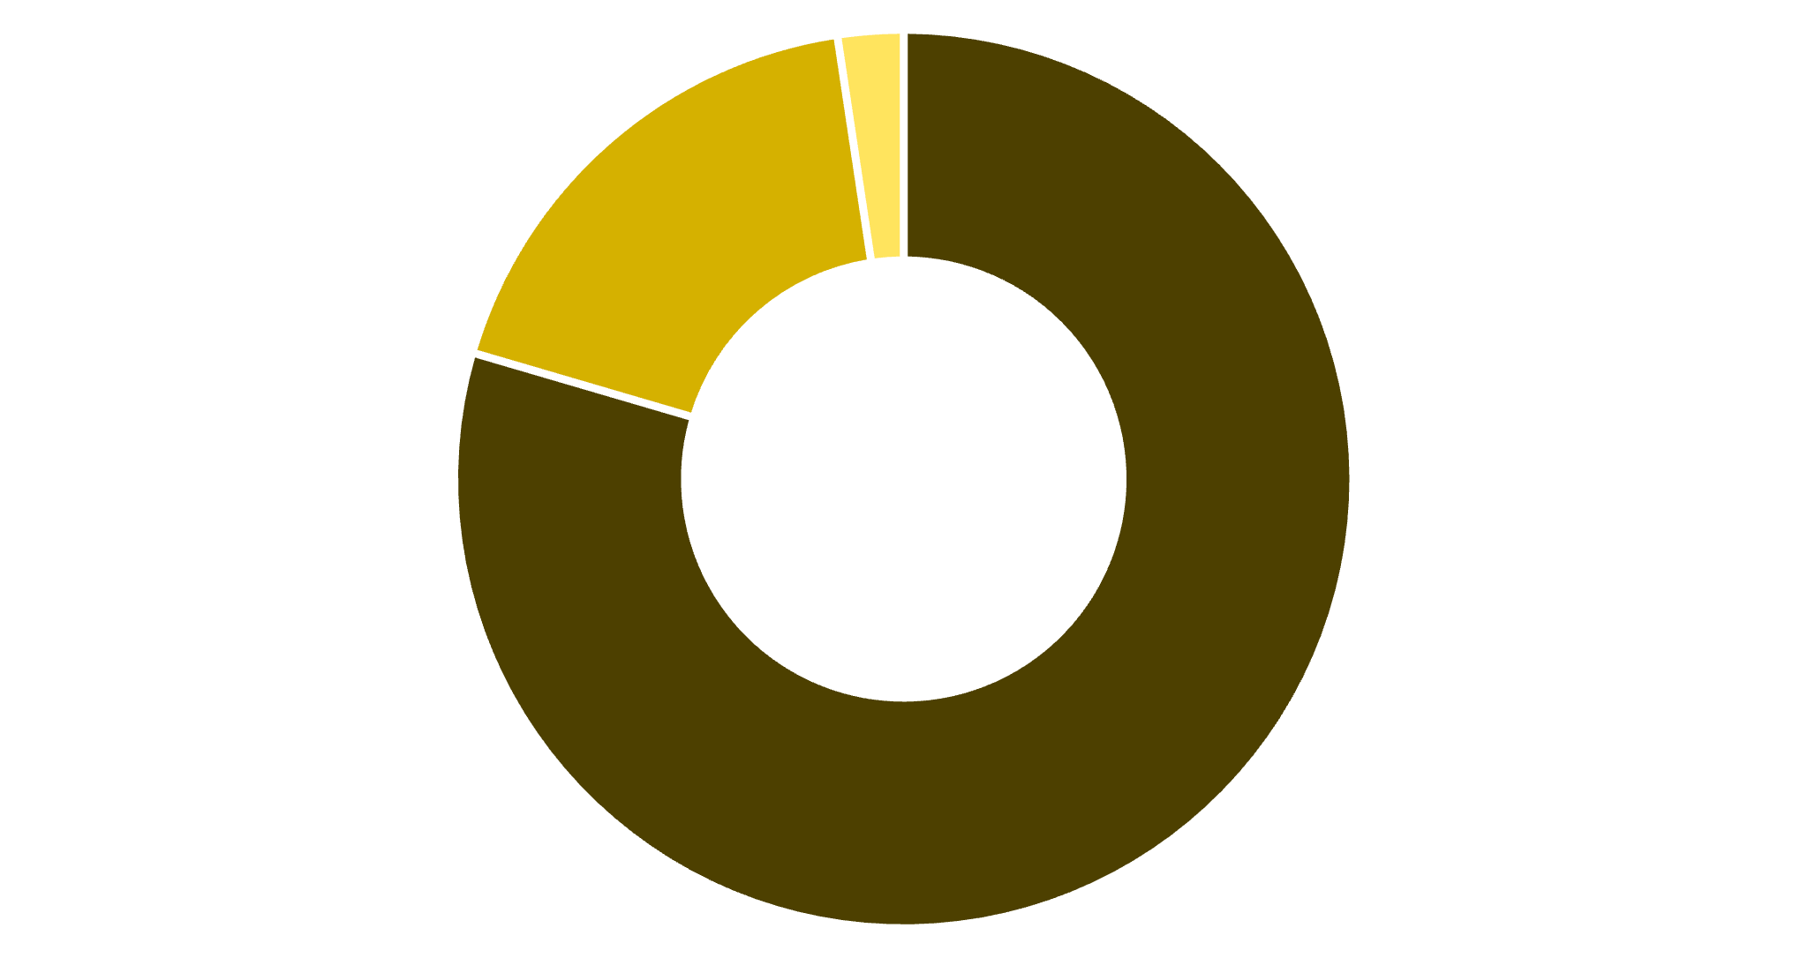
Customer Segmentation & Loyalty
Segment Breakdown
Of repeat buyers with 5+ purchases, 958 are subscribers while 2,518 are not—a clear conversion opportunity.
Loyal
Returning
New
Loyal (80%)
Returning (18%)
New (2%)
3,116 repeat customers form the core base
701 customers showing growth potential
83 first-time buyers to nurture

Slide 9

POWER BI DASHBOARD
Visual Analytics Platform
Interactive Power BI dashboard consolidates all insights with real-time filtering by gender, category, and shipping type. Key metrics include 3.9K customers, $59.76 average purchase, and 3.75 average rating across all segments.

Slide 10
ACTION PLAN
Strategic Business Recommendations
Boost Subscriptions
1
Promote exclusive benefits to convert the 73% non-subscriber base with targeted campaigns
Customer Loyalty Programs
2
Reward repeat buyers to accelerate movement from Returning to Loyal segment
Review Discount Policy
3
Balance sales boosts with margin control for high-discount products (Hats, Sneakers, Coats)
Product Positioning
4
Highlight top-rated items (Gloves, Sandals, Boots) in marketing campaigns
Targeted Marketing
5
Focus on high-revenue segments: Young Adults, express-shipping users, and male customers

